Slide 1


Nationwide Eclipse Ballooning Project 2022 - 2025
WV High Altitude Balloon Mission
WV Space Grant Consortium (WVSGC) and Trinity Christian School (TCS)

Slide 2
Overview
Mission Overview
Team
Mission Goals
Resources
Mission Concept
Team Responsibilities
Open Items

Slide 3
Mission Overview
YouTube Video: https://www.youtube.com/watch?v=CGcuzZx8ZvE
Montana Space Grant Consortium (MSGC) at Montana State University leads the National Eclipse Ballooning Project (NEBP) that was implemented during the 2017, 2019, and 2020 total solar eclipses
Building on previous success this new effort will broaden participation of STEM learners by immersing teams from a wide range of higher education institutions in an innovative NASA-mission-like adventure in data acquisition and analysis through scientific ballooning during the 2023 annular and 2024 total solar eclipses.
NEBP includes development and implementation of two learner-centered activity tracks – engineering and atmospheric science.
At sites along the eclipse path, student teams in the engineering track will use innovative larger balloon systems to live stream video to the NASA eclipse website, observe in situ perturbations in atmospheric phenomena, and conduct individually designed experiments.
Atmospheric science track teams will make frequent observations by launching hourly radiosondes on helium-filled weather balloons. Student participants will work with atmospheric science experts throughout the project and will publish results in peer-reviewed journals.
NEBP will fully support 70 teams.
The 70 teams will be divided into ten pods to facilitate effective education.
NEBP will provide a learning environment that uses evidence and equity-based practices to make certain the 1,000+ participants are (and feel) supported, engaged, and valued.
In addition, NEBP will provide infrastructure tools and best practices to help participating institutions build collaborations that could continue far beyond the scope of this project.

Slide 4
WV Space Grant and TCS
WVSGC and TCS was selected as 1 of the 70 teams building, launching, operating, and recovering engineering track high altitude balloons
Mission Launch
Annular Eclipse - October 14, 2023
Total Solar Eclipse - April 8, 2024
= Launch Sites
Engineering track teams will focus on first-hand experiences with designing and constructing stratospheric ballooning systems.
Team will fly large balloon platform capable of lifting 12 pounds of student-designed and -built payloads to 80,000 – 100,000 feet, streaming live video and collecting critical data along the way.
Typical engineering platform experiments include atmospheric measurements, photography, cosmic radiation measurements, and space technology proof-of-concept hardware.

Slide 5
The Team
Team Mentors:
Candy Cordwell – Assistant Director WV Space Grant Consortium
Marcus Fisher – NASA GSFC Senior Fellow and Trinity Christian School (TCS) STEM Teacher
Engineering Team:
TCS High School STEM Club
Utilize Computer Science Teachers Association to recruit schools across the state
Goal: each county from WV is represented
Reach out to Girls that code, CSTA Network, etc.
Students from WVU, Glenville State, Marshall, WV State
Project Managers and Systems Engineers (mentors):
WVU Engineering Students
Society of Women Engineers
Students from Glenville State, WV State, and Marshall University
Classroom / Laboratory from TCS is the build location
Getting team members badged?

Slide 6
Mission Goals
Enable inclusive STEM education for participating students, WV NEBP will engage the public and K-12 students getting them excited in the engineering and sciences of HAB
Administer state-wide campaigns to get a diversity of students competing in designing missions patches and outreach materials
Engage communities within the state of WV by running a campaign where citizens of the state can submit their names to fly on board the HAB during the eclipse
Administer monthly knowledge-sharing events across the state of WV regarding engineering and sciences of HAB.
Contact each of the 57 K-12 school districts in WV to engage with and invite them to participate in outreach, data analysis, or as part of the engineering team
To advance learners’ understanding of the process of science, WV NEBP will introduce high school and University classes across the state of WV that offer yearly engineering classes centered on HAB
High school classes would be a year-long class (Systems engineering focused on cyber-security and HAB)
University class would be one-semester classes (Systems engineering focused on cybersecurity and HAB)
To create, enhance, and sustain networks, WV NEBP will advance the engineering of real-time systems by developing and utilizing a software-only simulation of the HAB that future teams can use to help test and simulate the entire system during development
Team captains from four Universities (one of the two only HBCU/MSI in WV included) are committed to peer/peer recruitment and outreach.
Using the success model of the statewide SPOT program, team captains will present the simulation and develop experiments for age-appropriate audiences. We will enhance the public’s understanding and general knowledge about NASA and the HAB project through public seminars and workshops.
Team mentors will pitch the idea of Industry sponsoring underrepresented students (groups, schools) to fly experiments on HAB

Slide 7
Resources
NEBP Project
All equipment and supplies
Lessons and skill training
Helium for both eclipses (2023 and 2024)
Up to 3k for travel to workshop
WV Space Grant
Team mentor
Funding for team travel for launches (2023 and 2024)
Funding for team mentors to attend regional workshop in May 2023
Stipends to undergraduate students (possibly for high school students as summer internships)
University students – Spring independent study or special topics course
Helium Purchase (practice flights, 2023 and 2024 mission flights)
Satellite modem tracking device fees (NAL Research Iridium modem and service)
Trinity Christian School
Team mentor
Computer Engineering class and STEM clubs
Classroom, laboratory space, and equipment (computers, electronics, 3D printers, oscilloscopes, soldering, electronic benches)

Slide 8
WVSGC-TCS: Mission Concept
High Altitude Balloon System (see next slide)
Recruit one school from each county in WV to participate
Participation can be in various ways (i.e., outreach, data analysis, payload development)
Conduct state-wide challenge to acquire mission logo
Conduct state-wide challenge to have public submit their names to fly on board mission
Conduct outreach across the state regarding HAB and science
Conduct monthly lunch and learns broadcasted across state
Develop High School engineering class in cybersecurity and HAB
Develop University class in systems engineering with HAB as project
Develop software-only simulation of HAB system (including System Model)

Slide 9
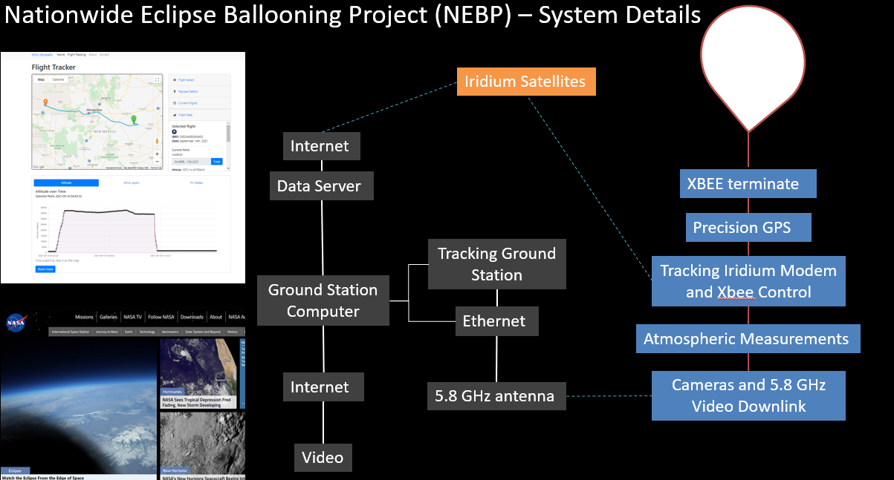
High Altitude Balloon (HAB) System
Parachute

Slide 10
High Altitude Balloon (HAB) System (cont.)
Potential Additional Objectives:
Develop and test the use of AWS ground station services by having multiple schools across WV develop ground stations and test AWS ground station services
Depending on weight:
Atmospheric Science / Gravitational Wave Experiment
Technology Demonstration: Image processing payload using nVidia Jetson boards and Java

Slide 11
Team Responsibilities
HAB System
WVUSGC
TCS
?
Balloon
Parachute
xBee cut away
GPS
Tracking Modem
Camera & 5.8 GHz Video Downlink
Ground System
NASA Data Server
Tracking Station & 5.8 GHz Antenna
Ground Station
Atmospheric Measurement
Payload A
Payload B
?
Amazon Web Service (AWS)
Experimental Ground System
?
Initiative Leads
Project Management
State-wide mission logo
State-wide submitting names
Outreach across state in HAB and Science
Monthly Lunch & Learns
Mission Web Site & Blogging
Shared Document Space (i.e. Github)
Summer Workshop
High School Class Development
University Class Development
System Model
Software Only Simulation
?

Slide 12
Open Items
Additional payloads:
Depending on weight, may have room for 2
Eclipse induced atmospheric gravity waves
Artificial intelligence and/or machine learning
Quantum computing
Radio astronomy
Additional Organizations
WV State
Marshal University
Glenville State
Girls that Code
Society of Woman Engineers
1 high school from each county across WV

Slide 13
Open Items (cont.)
Travel and Lodging:
Regional Workshop in May 26-30, 2023
College Park Maryland
Fisher and 2 team members (need 3 team members)
Annular Eclipse: October 14, 2023
NW Texas - Vanderpool Texas (24 hour drive)
Total Eclipse: April 8, 2024
NW Pennsylvania
Helium Tanks
4 tanks (2 for each flight)
Tanks for any test flights?
Physical Space
TCS computer engineering lab (do we need clean room?)
Test Flights
Team will need to do test flights, especially parachutes
Could use drop tower at WVU or do fund raiser to pay for additional balloon flights

